Slide 1
ACID Properties in DBMS

Slide 2
#1 Atomicity It simply says “All or Nothing”
At time 2:00pm----------------IMPS/PAYTM
Amazon/flipkart/ebay
Purchased edible stuff—Rs 200
We added the card details-proceeded for payment->otp generated
We typed OTP and hit enter→
Internet connection lost---
Money gets deducted from our account
but is not received by the ecommerce company → reverted back to our account in a week.
“ROLLBACK”/”ABORT”
IF no internet error→
“Transaction COMMITTED”

Slide 3
#2 Consistency Every attribute in the database have some rules to ensure the stability of the database. Constraint puts on the data value should be constant before and after the execution of the transaction.
If the system fails because of the invalid data while doing an operation, revert back the system to its previous state.
Handling Inconsistencies
Fixing Inconsistent Data- implicit conversion –e.g. Mr. instead of Mrs. in patient name. or implicit conversion of a datatype, or it can cascade a delete/update to maintain referential integrity
Giving Up And Rolling Back- sometimes a blood sample arrives clotted when it should have arrived unclotted (or vice versa) then whole test has to be rejected to be performed again correctly. SQL Server will do this whenever it’s necessary to maintain consistent data. It will raise an error and the entire statement or transaction is undone (to be corrected and performed again).

Slide 4
Isolation: Events within a transaction must be hidden from other transactions running concurrently.
If there is any other transaction (between Mac and Alice) going, it should not make any effect on the transaction between Alice and Bob. Both the transactions should be isolated.
T1-----MOM-deposit-500-Jaya(write) T2----Jaya-read mini statement-ATM(read)
T2 should throw error, as T1 has locked the resource.
After a while again T2 tries to read then data should be shown
Different Levels of Isolation
READ UNCOMMITTED, -A dirty read occurs when a transaction reads a record that has not yet been committed. reading tentative data. The only isolation level in which dirty reads are possible is READ UNCOMMITTED.
READ COMMITTED, -The non-repeatable read occurs when a transaction re-reads a single record and finds that it has been changed or deleted. When data has changed, you have to decide whether you want consistent data or whether you want current data.

Slide 5
REPEATABLE READ -A phantom read occurs when your transaction retrieves rows using the same criteria and new rows are returned. In this case, either the new rows you see have been inserted or data has changed in existing rows such that these rows now meet the filter criteria. Either way these rows are new to you. The Phantom Read is a phenomenon that deals with queries that return sets. The thing that’s changing in a phantom read is not the data in the rows; it’s the set membership that has changed.
SERIALIZABLE-made available in order to avoid dirty, non-repeatable or phantom read. SERIALIZABLE transactions see database data as if there were no other transactions running at the same time. Its uses locks for the same.
SNAPSHOT uses a copy of committed data
___________________________________________________________________________________
Degrees of isolation¹:
degree 0 - a transaction does not overwrite data updated by another user or process ("dirty data") of other transactions
degree 1 - degree 0 plus a transaction does not commit any writes until it completes all its writes (until the end of transaction)
degree 2 - degree 1 plus a transaction does not read dirty data from other transactions
degree 3 - degree 2 plus other transactions do not dirty data read by a transaction before the transaction commits

Slide 6
#4 Durability After Completion of Transaction:
The changes made during the transaction should exist after completion of the transaction.
Transaction to transfer $50 from account A to account B:
1. read(A)
2. A := A – 50
3. write(A)
4. read(B)
5. B := B + 50
6. write(B)
once the user has been notified that the transaction has completed (i.e., the transfer of the $50 has taken place), the updates to the database by the transaction must persist even if there are software or hardware failures.
E.g.- IMPS at non-office hours, will show legendary balance and total amount both. It gets refreshed in office hours.

Slide 7
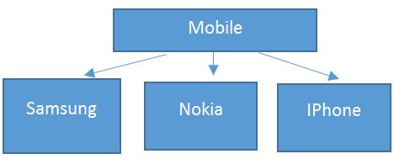
OOPS
CLASS
Objects
Abstraction It says, only show relevant details and rest all hide it.
Dialing a number call some method internally which concatenate the numbers and displays it on screen but what is it doing we don’t know.
Clicking on green button actual send signals to calling person’s mobile but we are unaware of how it is doing.

Slide 8
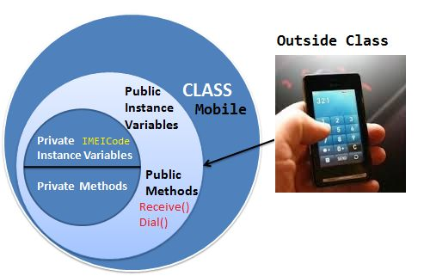
Encapsulation
enclosing one or more details from outside world through access right.
Both Abstraction & Encapsulation works hand in hand
Abstraction says what details to be made visible & Encapsulation provides the level of access right to that visible details. i.e. – It implements the desired level of abstraction.
-Bluetooth in our mobile. When we switch on the Bluetooth I am able to connect another mobile but not able to access the other mobile features like dialing a number, accessing inbox etc. This is because, Bluetooth feature is given some level of abstraction.
- Mobile A is connected with mobile B via Bluetooth whereas mobile B is already connected to mobile C then A is not allowed to connect C via B. This is because of accessibility restriction. This is handled by access specifier like public, private, protected, and internal

Slide 9
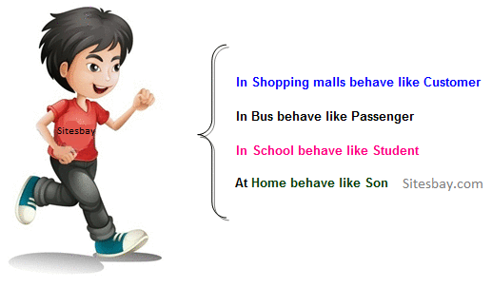
Polymorphism
ability of doing the same operation but with different type of input.
Camera-click photos
Camera-Click photo & portrait mode
Same functionality –overloaded method with additional functionality
(Compiler checks the type and number of parameters passed to the method and decides which method to call )
Static Polymorphism-overriding
Dynamic Polymorphism-upcasting

Slide 10
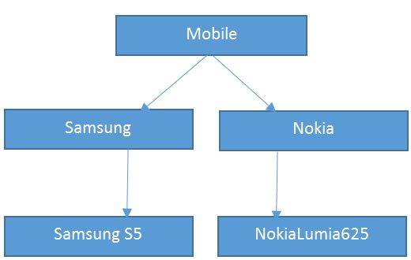
Inheritance
Ability to extend the functionality from base entity in new entity belonging to same group.
Basic Mobile functionality is to Send Message, dial & receive call. So the brands of mobile is using this basic functionality by extending the mobile class functionality and adding their own new features to their respective brand.

Slide 11
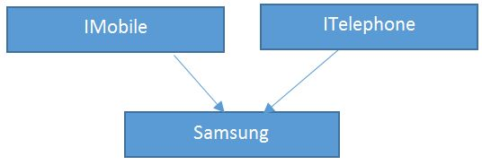
Interface
Written Contract of specification .
enforces the class to have a standard contract to provide all implementation to the interface members.
Main purpose –Standarization
e.g. Making of Druga Idol or doing any Puja.
Steps are fixed and enforced but implemented in different ways.

Slide 12
Dependency Injection
A dependency is an object that can be used (a service)
An injection is the passing of a dependency to a dependent object (a client) that would use it. The service is made part of the client's state. Passing the service to the client, rather than allowing a client to build or find the service, is the fundamental requirement of the pattern.
water
I liter
JUG
water
I liter

Slide 13
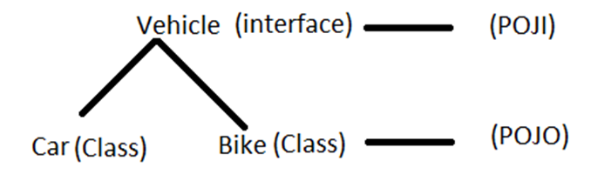
Coupling InTER – Module Concept.
Tight Coupling
Public class Traveller {
Car c = new Car();
Public void startJourney() {
c.move();
}
}
Public class Car {
Public void move(){
...
}
}
traveller object is tightly coupled with car object. If traveller wants to change from car to plane then the whole traveller class has to be changed
Public class Traveller {
Plane p = new Plane();
Public void startJourney() {
p.move();
}
}
Public class Plane {
Public void move(){
...
}
}
Loose Coupling
Public class Traveller {
Vehicle v;
Public void setV(Vehicle v) {
this.V = V;
}
Public void startJourney() {
V.move();
}
}
Here in traveler class, an external entity injects either car (or) Bike object.
Coupling is the to which one class knows about another class. Or How much one class needs other class to execute. Relationship with other modules or classes degree
If class A relies on parts of class B that are not part of class B's interface, then the coupling between the classes is tighten that is not a good thing
Here what is move function of car is modified , we have no knowledge of class Traveler coupled with it, then it might break the class.

Slide 14

Cohesion
Cohesion makes water drop a drop
Intra – Module Concept.
Functionality of modules are strongly related -high cohesion- better
The term cohesion is used to indicate the degree to which a class has a single, well-focused purpose.
// More cohesive class design class BudgetReport { Options getReportingOptions() { } void generateBudgetReport(Options o) { } } a class ConnectToRDBMS { DBconnection getRDBMS() { } } class PrintStuff { PrintOptions getPrintOptions() { } } class FileSaver { SaveOptions getFileSaveOptions() { } }
// Less cohesive class design
class BudgetReport {
void connectToRDBMS() { }
void generateBudgetReport() { }
void saveToFile() { }
void print() { }
}

